Slide 1
Tries
Prepared by:
Dr Annushree Bablani

Slide 2
Introduction
Numbers as key values: are data items of constant size, and can be compared in constant time.
In real applications, text processing is more important than the processing of numbers
We need different structures for strings than for numeric keys.

Slide 3
Motivating Example
Example: 112 < 467 , Numerical comparison in O(1).
Compare Strings lexicographically does not reflect the similarity of strings.
Western > Eastern , Strings comparison in O(min(|s1|,|s2|)). where |s| denotes the length of the string s
Text fragments have a length; they are not elementary objects that the computer can process in a single step.
Pneumonoultramicroscopicsilicovolcanoconiosis !!!

Slide 4
Applications
Bioinformatics
Search Engines.
Spell checker.

Slide 5
Tries
The basic tool for string data structures, similar in role to the balanced binary search tree, is called “trie”
Derive from “retrieval.” (Pronounced either try or tree)
In this tree, the nodes are not binary. They contain potentially one outgoing edge for each possible character, so the degree is at most the alphabet size |A| .

Slide 6
Tries cont.
Prefix Vs. Suffix.
Ex. “computer”.
Prefix:(c, co, com).
Suffix: (r, er, ter)
Each node in this tree structure corresponds to a prefix of some strings of the set.
If the same prefix occurs several times, there is only one node to represent it.
The root of the tree structure is the node corresponding to the empty prefix.

Slide 7
Tries Example
Example: standard trie for the set of strings
S = { bear, bell, bid, bull, buy, sell, stock, stop }

Slide 8
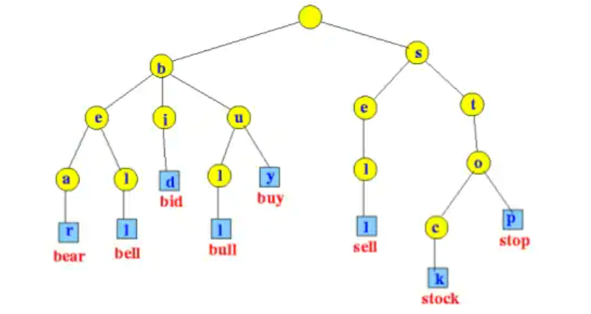
Tries
Standard Tries
Compressed Tries
Suffix Tries

Slide 9
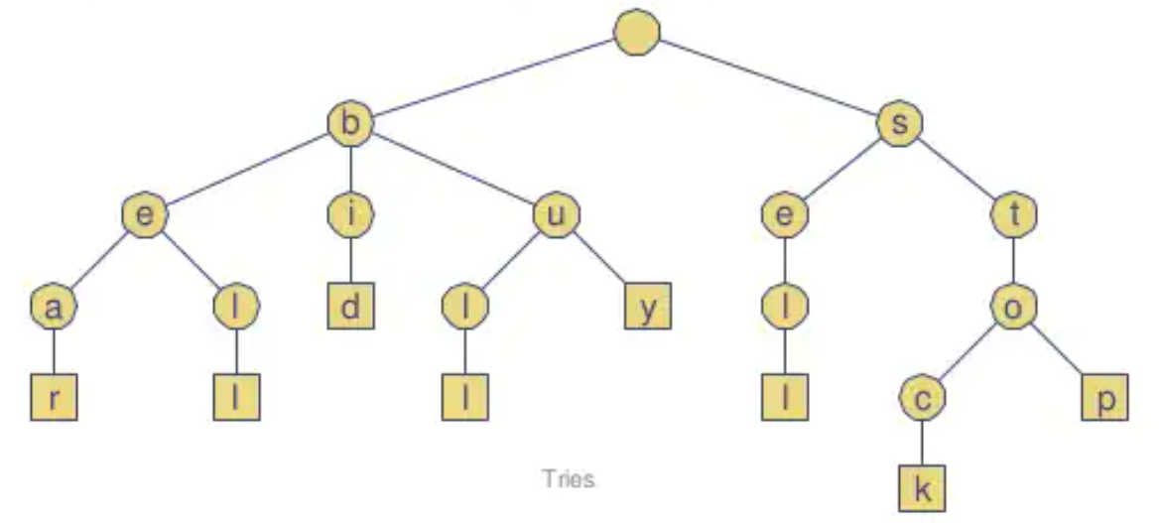
Standard Tries
The standard trie for a set of strings S is an ordered tree such that:
each node except the root is labeled with a character
the children of a node are alphabetically ordered
the paths from the external nodes to the root yield the strings of S
Example: standard trie for the set of strings
S = { bear, bell, bid, bull, buy, sell, stock, stop }
A standard trie uses O(n) space. Operations (find, insert, remove) take time O(dm) each, where:
-n = total size of the strings in S,
-m =size of the string parameter of the
operation
-d =alphabet size,

Slide 10
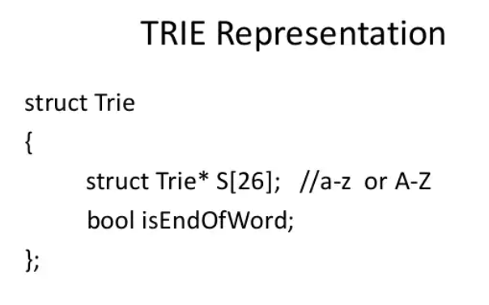

Slide 11
Applications of Tries
A standard trie supports the following operations on a preprocessed text in time O(m), where m = |X|
-word matching: find the first occurrence of word X in the text
-prefix matching: find the first occurrence of the longest prefix of word X in the text
Each operation is performed by tracing a path in the trie starting at the root

Slide 12
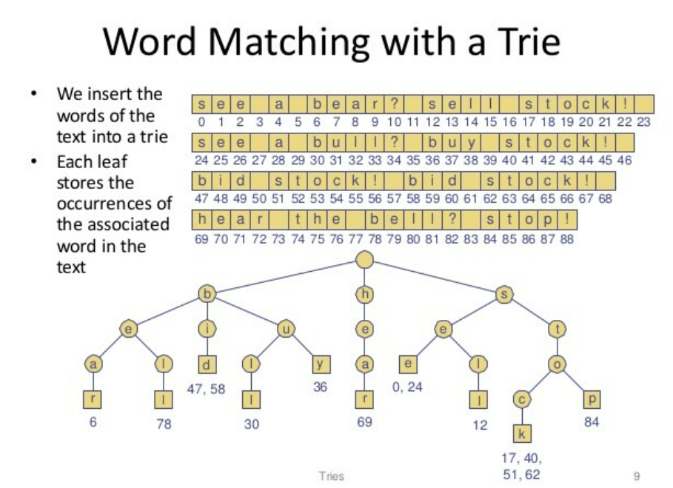

Slide 13
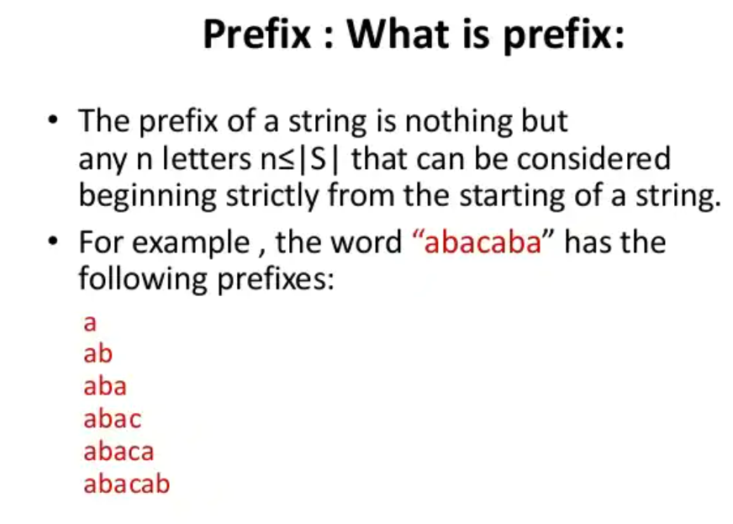

Slide 14
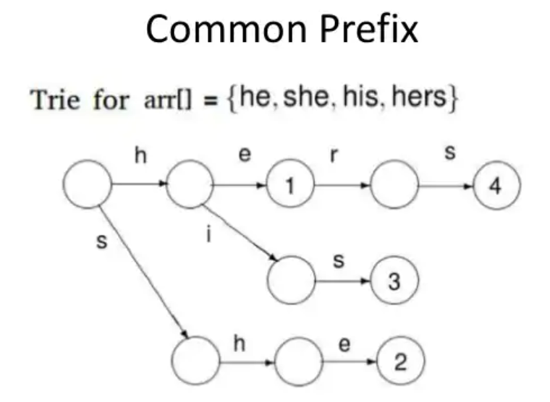

Slide 15
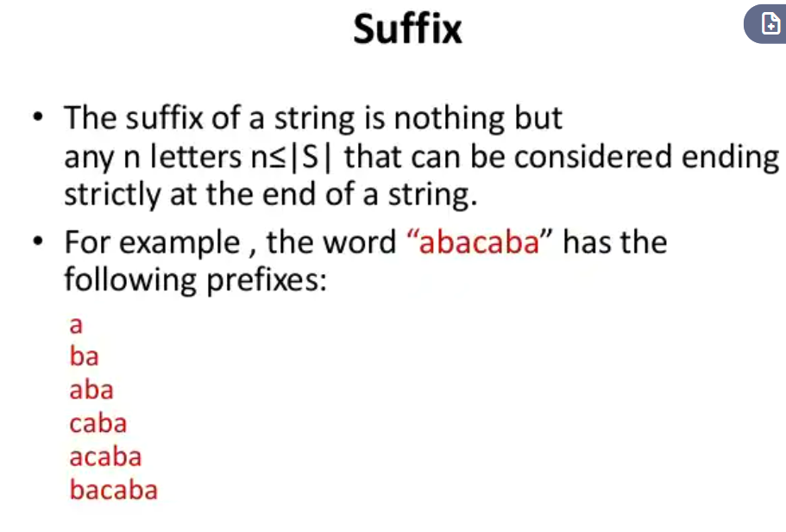

Slide 16
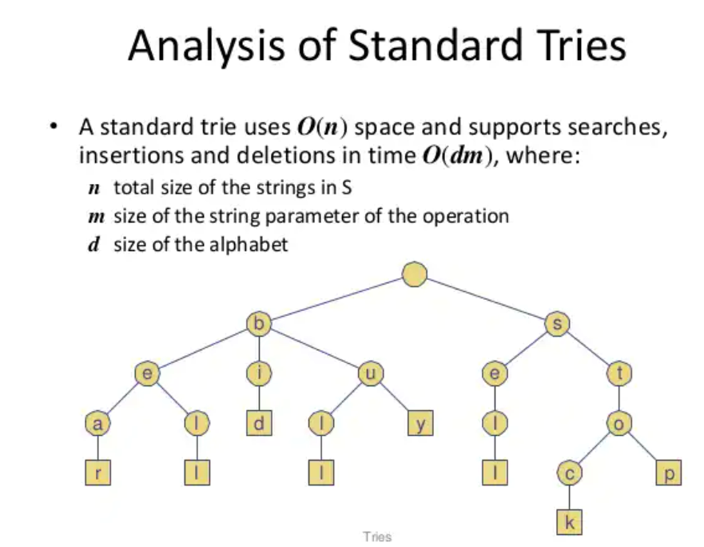

Slide 17
Find, Insert and Delete
To perform a find operation in this structure:
Start in the node corresponding to the empty prefix.
Read the query string, following for each read character the outgoing pointer corresponding to that character to the next node.
After we read the query string, we arrived at a node corresponding to that string as prefix.
If the query string is contained in the set of strings stored in the trie, and that set is prefix-free, then this node belongs to that unique string.

Slide 18
Find, Insert and Delete
To perform an insert operation in this structure:
Perform find
Any time we encounter a nil pointer we create a new node.
Example:
Insert “extra”
e
x
t
a
r
m
a
\0
\0

Slide 19
Find, Insert and Delete
To perform a delete operation in this structure:
Perform find
Delete all nodes on the path from ‘\0’ to the root of the
tree unless we reach a node with more than 1 child
Example:
Delete “extra”
e
x
t
a
r
m
a
\0
\0

Slide 20
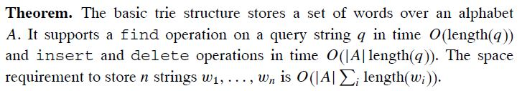
Performance
Find: All the characters in the word = O(|q|) where q: query string
Insert: first find then insert an array of length |A| as a node = O(|q|.|A|)
Delete: first find then delete an array of length |A| as a node = O(|q|.|A|)
We can get rid of the |A| dependence in the delete operation by using reference counts.
All new nodes must be initialized with NULL pointers, so the |A| dependence in the insert operation does not disappear.

Slide 21
Alphabet Size
The problem here is the dependence on the size of the alphabet which determines the size of the nodes.
There are several ways to reduce or avoid the problem of the alphabet size.
A simple method, is to replace the big nodes by linked lists of all the entries that are really used.

Slide 22
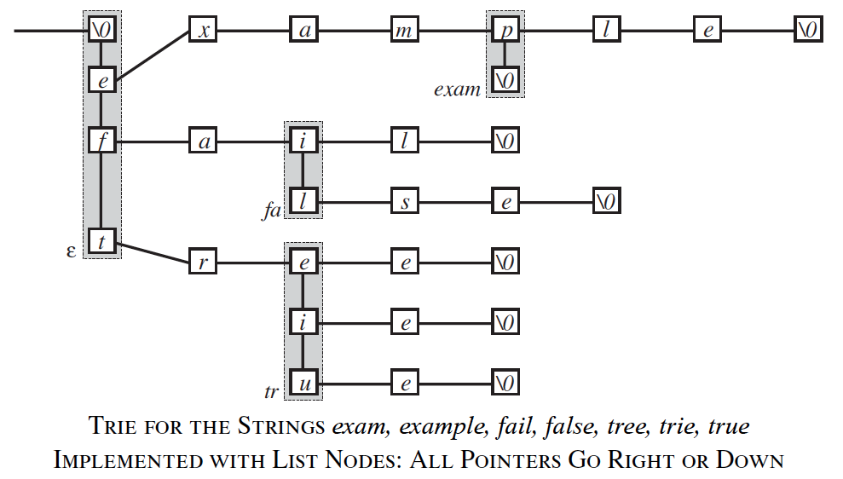
List Example

Slide 23
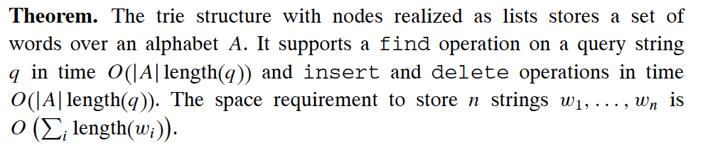
Lists Performance
Find, Insert and delete: O(|q|.|A|)

Slide 24

Alphabet Size
Another way to avoid the problem with the alphabet size |A| is alphabet reduction.
We can represent the alphabet A as set of k -tuples from some direct product
By this each string gets longer by a factor of k , but the alphabet size can be reduced to

Slide 25
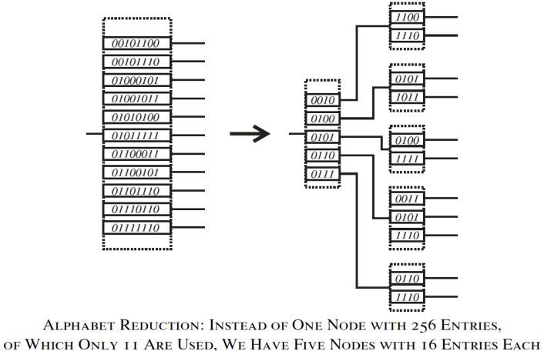
Alphabet Reduction Example
For the standard ASCII codes, we can break each 8-bit character by two 4-bit characters, which reduces the node size from 256 pointers to 16 pointers

Slide 26
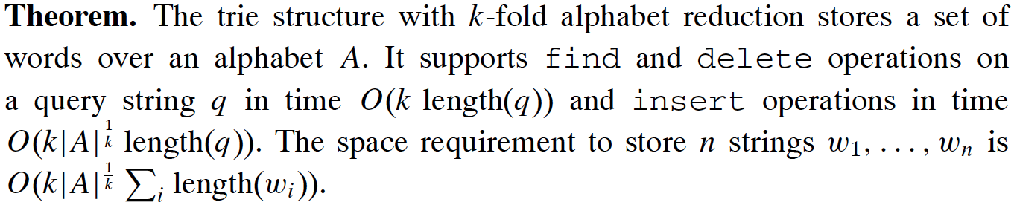
Reduction Performance

Slide 27



Other Reduction Techniques
The trie structure with balanced search trees as nodes:
Find, insert and delete Time:
Space:
The ternary trie structure: nodes are arranged in a manner similar to a binary search tree, but with up to three children. each node contains one character as key and one pointer each for query characters that are smaller, larger, or equal
Find time:
Space:

Slide 28
Patricia Tree
“Practical Algorithm To Retrieve information Coded in Alphanumeric.”
A path compression trie.
Instead of explicitly storing nodes with just one outgoing edge, we skip these nodes and keep track of the number of skipped characters.
The path compressed trie contains only nodes with at least two outgoing edges.

Slide 29
Patricia Tree
It contains a number, which is the number of characters that should be skipped before the next relevant character is looked at.
This reduces the required number of nodes from the total length of all strings to the number of words in our structure.
We need in each access a second pass over the string to check all those skipped characters of the found string against the query string.
this technique to reduce the number of nodes is justified only if the alphabet is large.

Slide 30
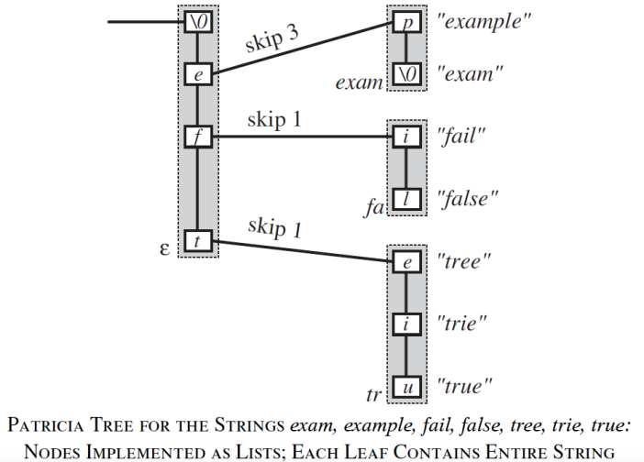
Patricia Tree: Example

Slide 31
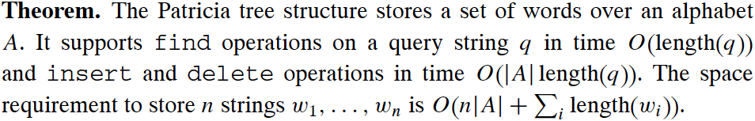
Patricia Tree: Insert & Delete
The insertion and deletion operations create significant difficulties.
We need to find where to insert a new branching node, but this requires that we know the skipped characters.
One (clumsy) solution would be a pointer to one of the strings in the subtrie reached through that node, for there we have that skipped substring already available.

Slide 32
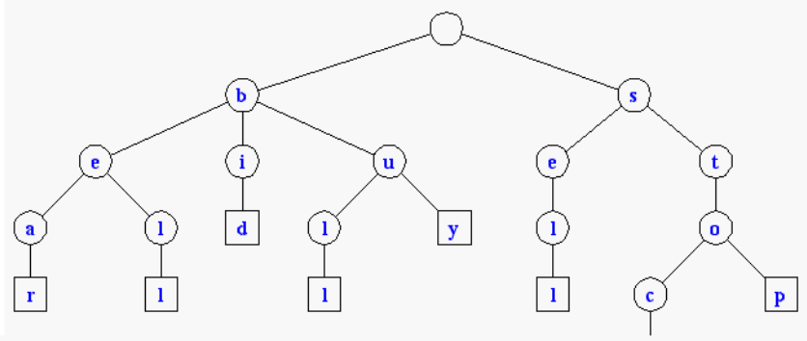
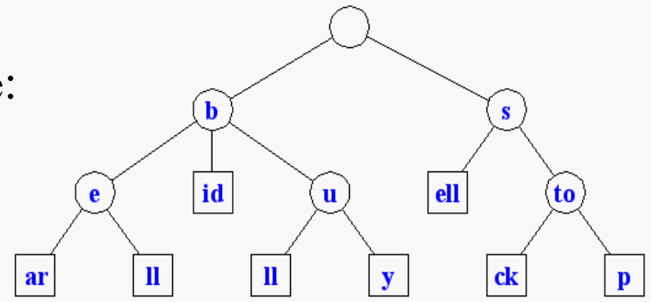
Compressed Tries
Trie with nodes of degree at least 2
Obtained from standard trie by compressing chains of redundant nodes
Standard Trie:
Compressed Trie:

Slide 33
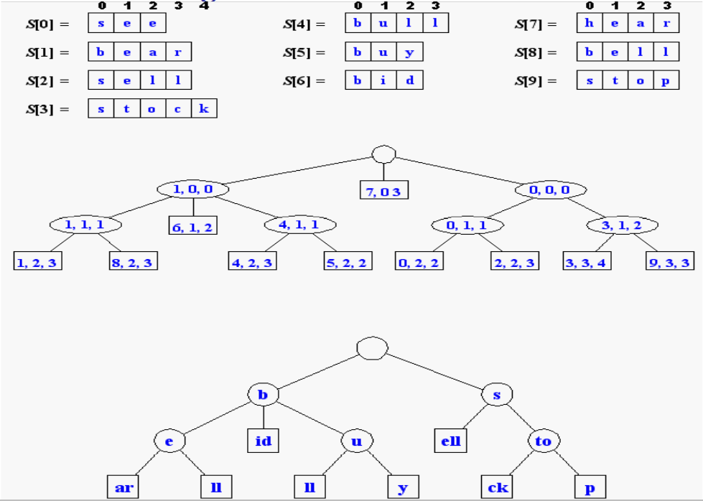
Compact Storage of Compressed Tries
A compressed trie can be stored in space O(s), where s = |S|, by using O(1) space index ranges at the nodes

Slide 34
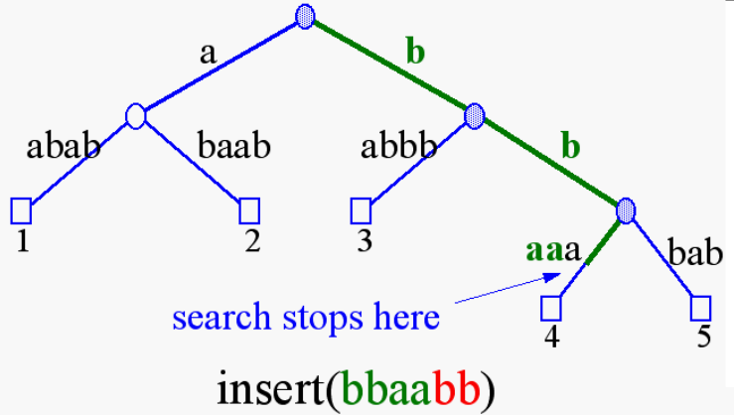
Insertion and Deletion into/from a Compressed Trie

Slide 35
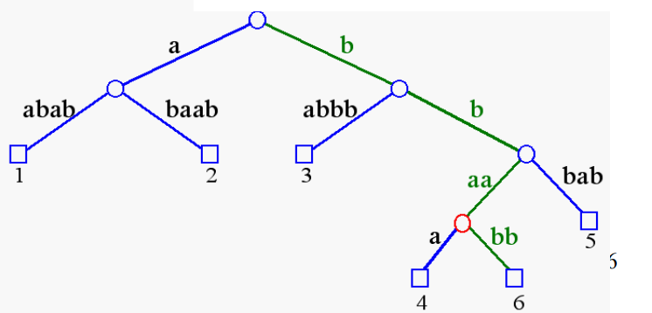
Insertion and Deletion into/from a Compressed Trie

Slide 36
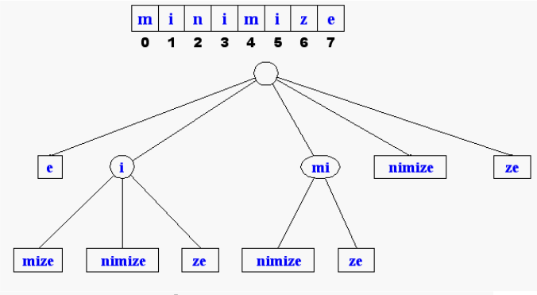
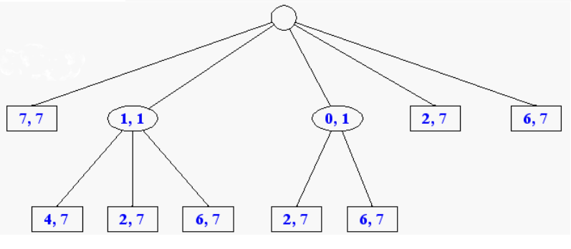
Suffix Tries
A suffix trie is a compressed trie for all the suffixes of a text
Example:
Compact representation:

Slide 37
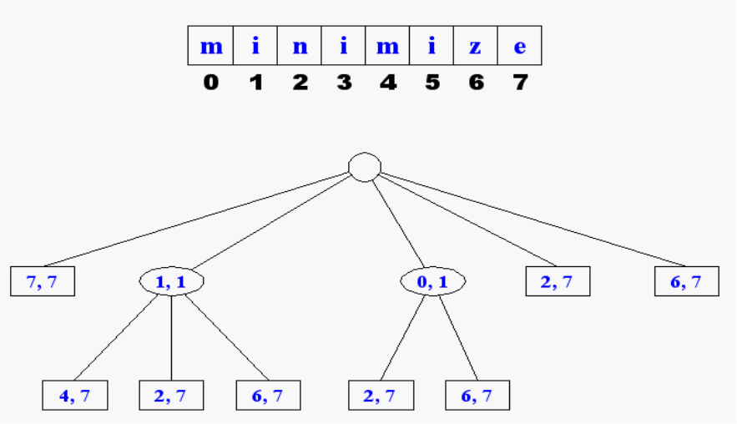
Properties of Suffix Tries
The suffix trie for a text X of size n from an alphabet of size d
-stores all the n(n-1)/2 suffixes of X in O(n) space
-supports arbitrary pattern matching and prefix matching queries in O(dm) time, where m is the length of the pattern
-can be constructed in O(dn) time

Slide 38
Tries and Web Search Engines
The index of a search engine (collection of all searchable words) is stored into a compressed trie
Each leaf of the trie is associated with a word and has a list of pages (URLs) containing that word, called occurrence list
The trie is kept in internal memory
The occurrence lists are kept in external memory and are ranked by relevance
Boolean queries for sets of words (e.g., Java and coffee) correspond to set operations (e.g., intersection) on the occurrence lists
Additional information retrieval techniques are used, such as
stopword elimination (e.g., ignore “the” “a” “is”)
stemming (e.g., identify “add” “adding” “added”)
link analysis (recognize authoritative pages)

Slide 39
Tries and Internet Routers
Computers on the internet (hosts) are identified by a unique 32-bit IP (internet protocol) addres, usually written in “dotted-quad-decimal” notation
E.g., www.cs.brown.edu is 128.148.32.110
Use nslookup on Unix to find out IP addresses
An organization uses a subset of IP addresses with the same prefix, e.g., Brown uses 128.148.*.*, Yale uses 130.132.*.*
Data is sent to a host by fragmenting it into packets. Each packet carries the IP address of its destination.
The internet whose nodes are routers, and whose edges are communication links.
A router forwards packets to its neighbors using IP prefix matching rules. E.g., a packet with IP prefix 128.148. should be forwarded to the Brown gateway router.
Routers use tries on the alphabet 0,1 to do prefix matching.

